Slide 1

6th Grade Accelerated Math
Unit 9, Lesson 7 Describing and Interpreting Line Plots Volume 2, pg. 78

Slide 2


Benchmarks
MA.6.DP.1.4
Given a histogram or line plot within a real-world context, qualitatively describe and interpret the spread and distribution of the data, including any symmetry, skewness, gaps, clusters, outliers, and the range.
volume 2, pg. 78

Slide 3
Integrated Mathematical Thinking and Reasoning Standards
MA.K12.MTR.2.1 Demonstrate understanding by representing problems in multiple ways.
MA.K12.MTR.4.1 Engage in discussions that reflect on the mathematical thinking of self and others.
MA.K12.MTR.7.1 Apply mathematics to real-world contexts.
volume 2, pg. 78

Slide 4

Learning Targets
I can describe and interpret data represented on a line plot.
I can determine the similarities and differences between a line plot and a histogram.
volume 2, pg. 78

Slide 5

Warm-Up
volume 2, pg. 78

Slide 6
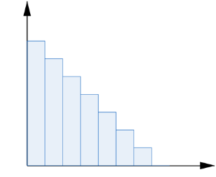
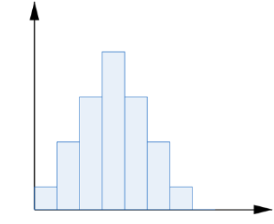
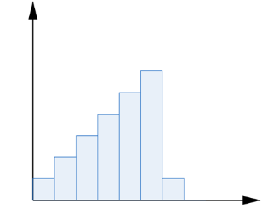
9.7.1 Warm-Up: Gathering Data
Categorize each histogram according to its shape by placing the letter in the appropriate box in the chart below.
Symmetric | Skewed Left | Skewed Right
A. | B. | C.
volume 2, pg. 78

Slide 7
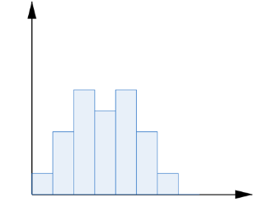
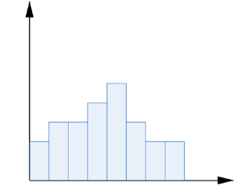
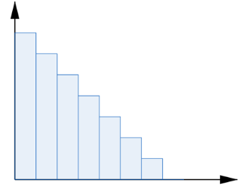
Symmetric | Skewed Left | Skewed Right
D. | E. | F.
volume 2, pg. 78

Slide 8

Guided Instruction
volume 2, pg. 79

Slide 9

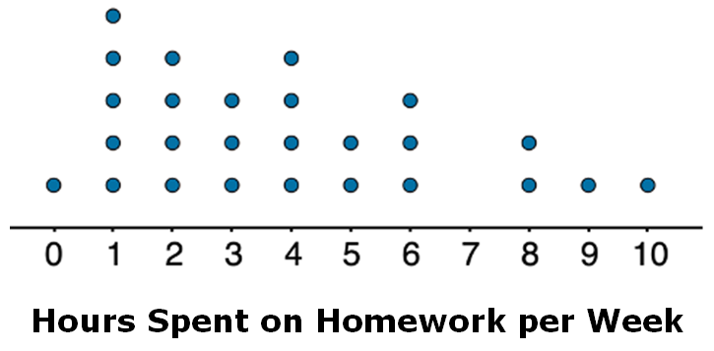
9.7.2 Guided Instruction: Describing and Interpreting Data Represented on Line Plots
Line plots are another way to display numerical data.
The line plot shows the number of hours per week that students reported spending on homework.
A line plot is a visual display of data values where each data value is shown as a dot or mark above a number line. This is also known as a dot plot.
volume 2, pg. 79

Slide 10
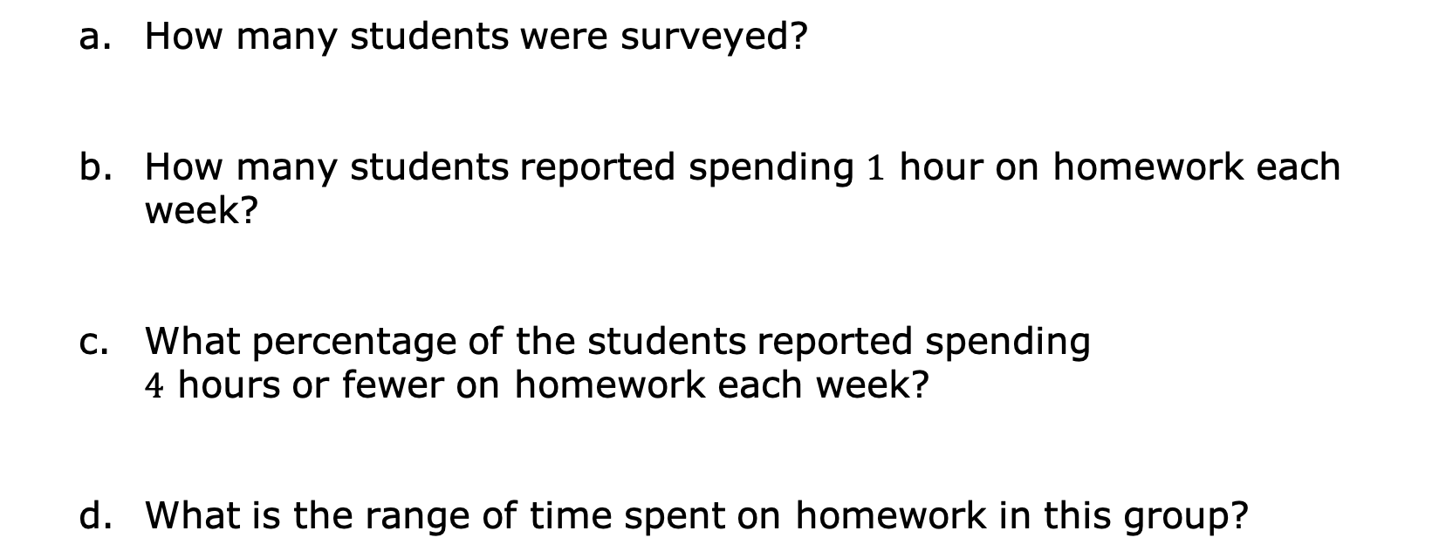
How many students were surveyed?
How many students reported spending $1$ hour on homework each week?
What percentage of the students reported spending $4$ hours or fewer on homework each week?
What is the range of time spent on homework in this group?
volume 2, pg. 79

Slide 11
With your partner, discuss and summarize your discussion on the following questions about the hours spent on homework per week.
Explain whether or not the mean time spent on homework by this group can be determined.
Someone said, “In general, these students spend roughly the same number of hours doing homework.” Do you and your partner agree? Explain your reasoning.
Describe the shape and special features of the distribution of hours spent on homework. Find another pair of partners and compare your descriptions.
volume 2, pg. 79

Slide 12
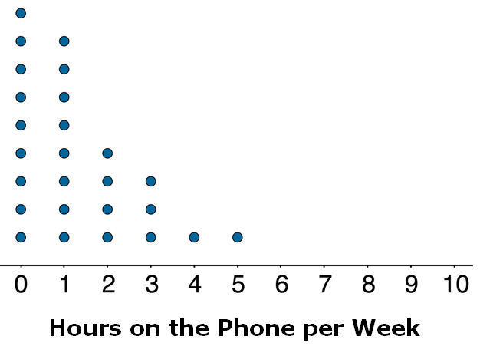
The same students were asked to estimate how many hours a week they spend talking on the phone. This line plot represents their reported number of hours of phone usage per week.
Describe the spread of the data.
volume 2, pg. 80

Slide 13
Overall, are these students more alike in the amount of time they spend talking on the phone or in the amount of time they spend on homework? Explain your reasoning.
Compare your reasoning with your partner. Make adjustments to your reasoning after the discussion with your partner, if necessary.
volume 2, pg. 80

Slide 14

Exploration
volume 2, pg. 80

Slide 15

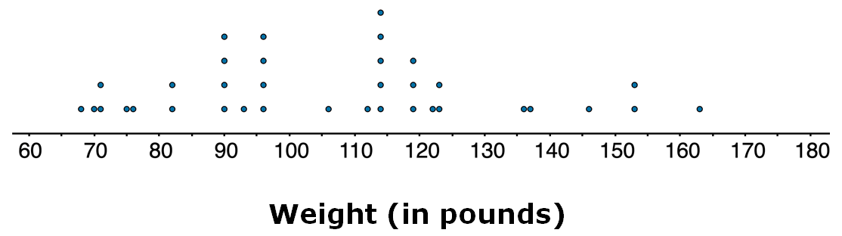

9.7.3 Exploration: Comparing Displays
The dot plot and histogram display the weights, in pounds, of $36$ dogs at a dog show.
volume 2, pg. 80

Slide 16
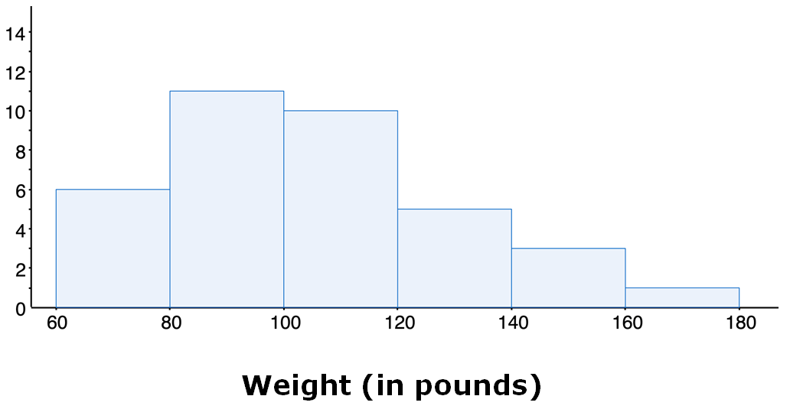
can be used to determine the number of dogs that weigh 90 lbs.
The line plot
The histogram
Both the line plot and histogram
volume 2, pg. 80

Slide 17
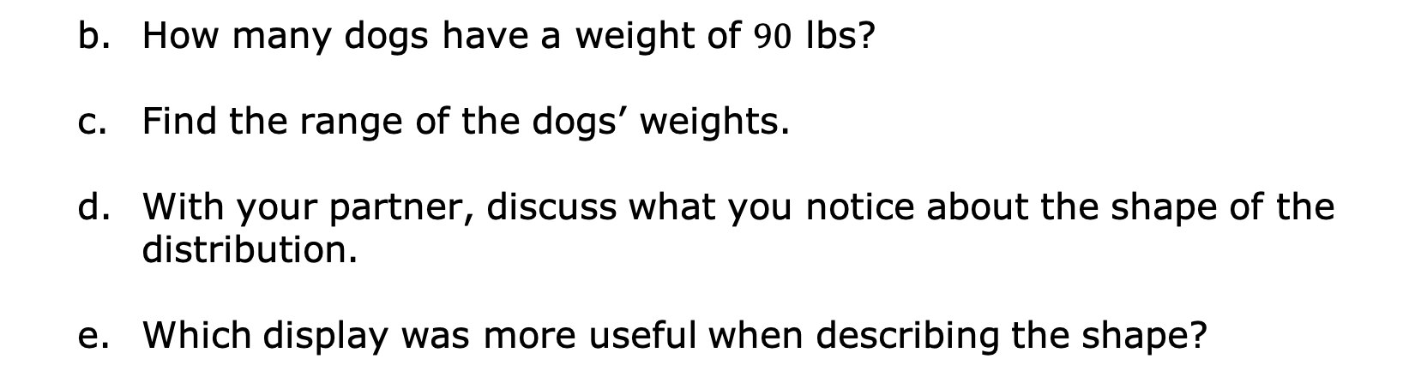
How many dogs have a weight of $90$ lbs?
Find the range of the dogs’ weights.
With your partner, discuss what you notice about the shape of the distribution.
Which display was more useful when describing the shape?
volume 2, pg. 81

Slide 18

Your Turn
volume 2, pg. 81

Slide 19
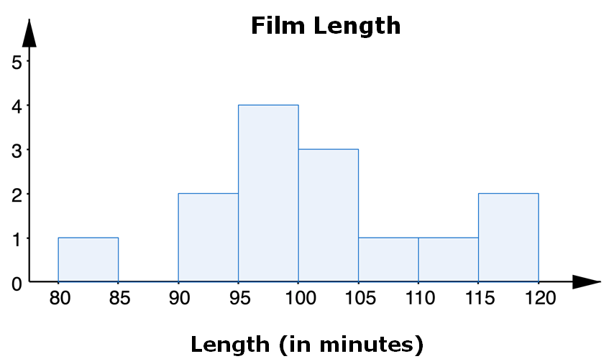
9.7.4 Your Turn!
A movie critic recorded the length, in minutes, of a sample of Pixar films and then made a histogram and a line plot of the data.
volume 2, pg. 81

Slide 20
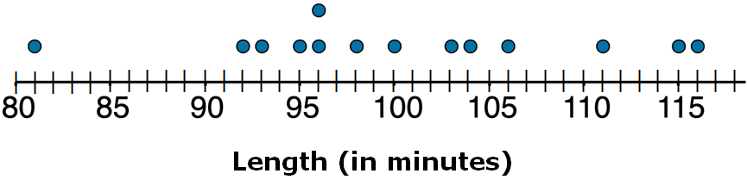

How many film lengths are recorded?
How many films are between $95$ and $100$ minutes in the histogram?
volume 2, pg. 81

Slide 21
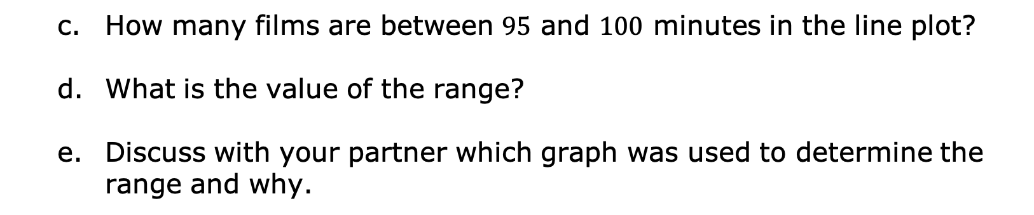
How many films are between $95$ and $100$ minutes in the line plot?
What is the value of the range?
Discuss with your partner which graph was used to determine the range and why.
volume 2, pg. 82

Slide 22
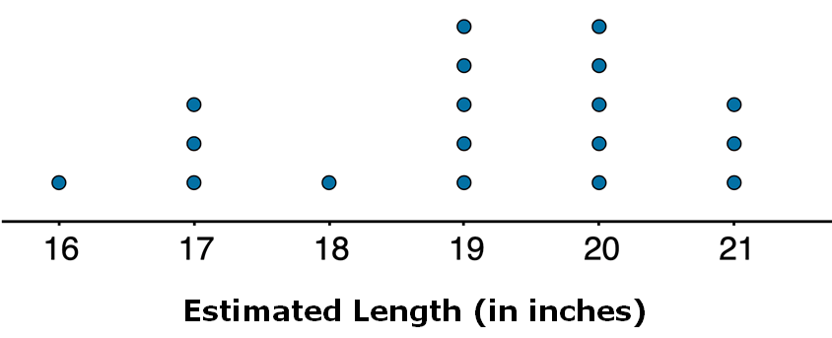
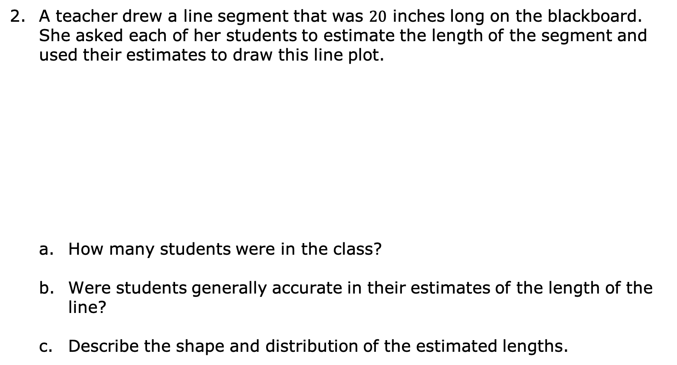
A teacher drew a line segment that was $20$ inches long on the blackboard. She asked each of her students to estimate the length of the segment and used their estimates to draw this line plot.
How many students were in the class?
Were students generally accurate in their estimates of the length of the line?
Describe the shape and distribution of the estimated lengths.
volume 2, pg. 82

Slide 23

Wrap-Up
volume 2, pg. 83

Slide 24
9.7.5 Wrap-Up: Reflection
Check all the statements that apply to your understanding.
I can read a line plot.
I need help reading a line plot.
I can describe and analyze data represented on a line plot.
I need help describing and analyzing data represented on a line plot.
I can determine the similarities and differences between a line plot and a histogram.
I need help to determine the similarities and differences between a line plot and a histogram for the same data.
volume 2, pg. 83

